Slide 1
Computer Science Lab 06
Université de Mostaganem — Dr. Madani BELACEL
ENS Year 1 — English Dept | 1h30 | BELACEL Madani
TP Computer Science Lab 06 • Diapositive 1/10
Notes:
TP 06 : HTML/CSS/Web
Module ENS
Dr. BELACEL Madani — Université de Mostaganem
Année 2026-2027

Slide 2

Lab objectives
Université de Mostaganem — Dr. Madani BELACEL
🎯 Python programming
🎯 Problem solving
🎯 Algorithm design
TP Computer Science Lab 06 • Diapositive 2/10
Notes:
TP 06 — Diapo 2/10
HTML/CSS/Web
HTML5 sémantique, CSS3, responsive, accessibilité

Slide 3
Exercise 1
Université de Mostaganem — Dr. Madani BELACEL
1️⃣ Read problem
1️⃣ Write code
1️⃣ Test output
TP Computer Science Lab 06 • Diapositive 3/10
Notes:
TP 06 — Diapo 3/10
HTML/CSS/Web
HTML5 sémantique, CSS3, responsive, accessibilité

Slide 4

Exercise 2
Université de Mostaganem — Dr. Madani BELACEL
2️⃣ Read problem
2️⃣ Write code
2️⃣ Test output
TP Computer Science Lab 06 • Diapositive 4/10
Notes:
TP 06 — Diapo 4/10
HTML/CSS/Web
HTML5 sémantique, CSS3, responsive, accessibilité

Slide 5
Exercise 3
Université de Mostaganem — Dr. Madani BELACEL
3️⃣ Read problem
3️⃣ Write code
3️⃣ Test output
TP Computer Science Lab 06 • Diapositive 5/10
Notes:
TP 06 — Diapo 5/10
HTML/CSS/Web
HTML5 sémantique, CSS3, responsive, accessibilité

Slide 6
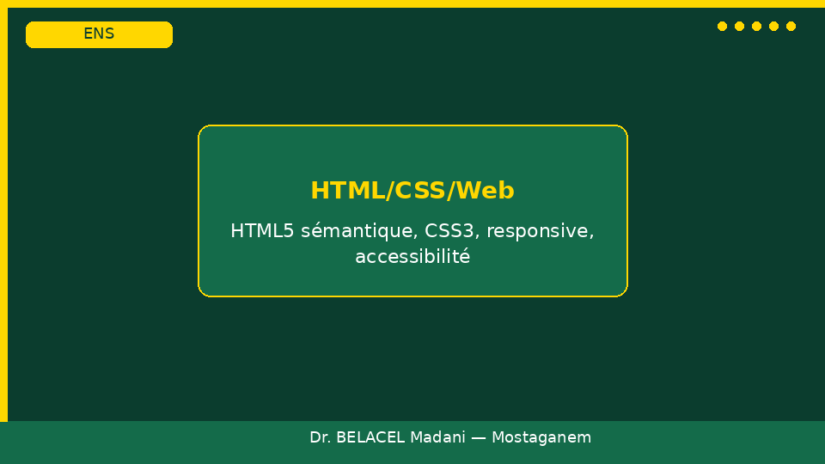
Exercise 4
Université de Mostaganem — Dr. Madani BELACEL
4️⃣ Read problem
4️⃣ Write code
4️⃣ Test output
TP Computer Science Lab 06 • Diapositive 6/10
Notes:
TP 06 — Diapo 6/10
HTML/CSS/Web
HTML5 sémantique, CSS3, responsive, accessibilité

Slide 7
Exercise 5
Université de Mostaganem — Dr. Madani BELACEL
5️⃣ Read problem
5️⃣ Write code
5️⃣ Test output
TP Computer Science Lab 06 • Diapositive 7/10
Notes:
TP 06 — Diapo 7/10
HTML/CSS/Web
HTML5 sémantique, CSS3, responsive, accessibilité

Slide 8
Grading Rubric
Université de Mostaganem — Dr. Madani BELACEL
✔️ 5 criteria × 20%
✔️ 0 = Not acquired
✔️ 0.5 = Partial
✔️ 1 = Acquired
TP Computer Science Lab 06 • Diapositive 8/10
Notes:
TP 06 — Diapo 8/10
HTML/CSS/Web
HTML5 sémantique, CSS3, responsive, accessibilité

Slide 9
Pedagogical Note
Université de Mostaganem — Dr. Madani BELACEL
📝 Teaching transposition
📝 Trainer advice
📝 Extension activities
TP Computer Science Lab 06 • Diapositive 9/10
Notes:
TP 06 — Diapo 9/10
HTML/CSS/Web
HTML5 sémantique, CSS3, responsive, accessibilité

Slide 10
End of lab
Université de Mostaganem — Dr. Madani BELACEL
✅ Submit your work (.py file)
✅ Questions?
TP Computer Science Lab 06 • Diapositive 10/10
Notes:
TP 06 — Diapo 10/10
HTML/CSS/Web
HTML5 sémantique, CSS3, responsive, accessibilité

